Slide 1
Dataset: Electronic Health Record
Data Analysis
Otobong Andy
MIS581
Dr Justin Bateh
Colorado State University Global
2/12/2023

Slide 2
Dataset: Electronic Health Records
The public dataset preferred for the project id electronic health records (EHR).
EHR is a digital version of the patient's paper chart (Blijleven et al., 2021).
On perfect implementation, EHR remains a valuable hub for information besides being a vital tool of communication across medical personnel.
Information from EHR provides the data which is analyzed and to guide the project in the achievement of its objective.
Physicians and the other healthcare personnel are able to research any drug given to patient or any other treatment, and the side effects and contraindication.
Notes:
Generally, EHR is chosen as a dataset for this project because it has been adopted in most of the medical facilities in this generation. It gives the healthcare personnel easy time while following up on their medication health. The physicians are able to trace sources of medical error and plan on how to counteract the effects. In this project, the EHR will help in identification of the frequencies of the medical errors, through the analysis of the data.

Slide 3
Cont’d
EHR is also considered in the project because it attracts the use of the big data analytics which are very important in the current digital world (Harrington, 2018).
The dataset will be effective with the application of various analytic tools which are discussed below.
It helps in the identification of a case a where the client has consulted with more than one physician but has not unveiled.
The miscommunication promotes the occurrence of error, which EHR helps enhances the elimination (Patton, 2018).
Notes:
The main reason behind the use of the EHR in this study is based in the fact that, it reveals all the history of the patient’s health even if some instances have been forgotten, because it is human to forget. This applies even if the patient went to various departments within or without the facility.

Slide 4
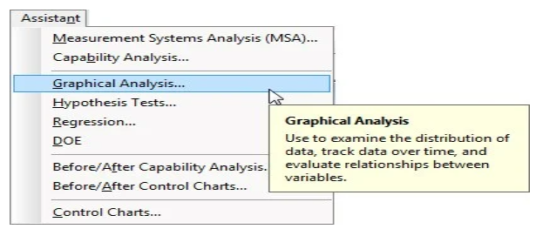
Graphical Analysis
Comprehensive data will be obtained from the EHR, on a random sample of a hundred medication errors, including the type of error and the time it took place.
Graphical analysis will apply as shown in the diagram aside.
Notes:
The decision tree will help in the identification of the types of medication errors that are frequent. Besides, the decision tree of the Assistant will guide one in the right direction. Incorporation of the Assistant will involve after knowing the kind of defects in the count data.

Slide 5
Before and After Control Chart
The before chart will be generated before counteracting the occurrence of the medical errors.
The Before chart will be developed to help in noting the effect of the medical errors in terms of frequency of occurrence and the major sources.
The ‘after control chart’ will come up after the implementation of change.
It will help in knowing whether there is reduction of the error.
The data set at this point will include the count of patients treated every week and the number of medication errors that took place.
The administrator will have an interest in knowing the effect of the changes.
Notes:
The process analysed above involve the selection of Assistant> Before/After charts. The chart help with the creation of the chat that makes it easy to recognize the changes that enhanced the achievement of the object of the study. The objective in this case involves reduction of medical error occurrence to one error per day.

Slide 6
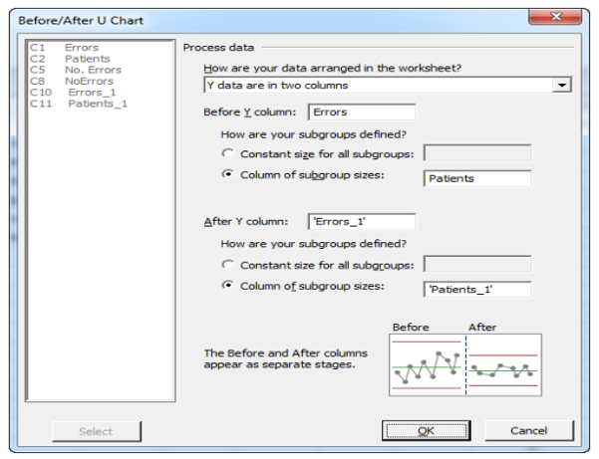
U chart
Based on the fact that every patient will be assumed to experience more than a single medication error, the Assistant decision tree will help in generating U chart.
Obtaining the U chart will involve completion of the dialog box as shown aside.
Notes:
From the diagram above, samples of before and after columns are indicated in the line graphs. They appear as separate stages indicating the situation of medical error before the intervention and after the intervention.

Slide 7
Questionnaires
The study will also incorporate the use of the quantitative surveys.
This requires the incorporation of the questionnaires.
The targeted respondents in this case include the healthcare professionals from all the departments of the ICU.
The questionnaires will enhance the ability of interrogating the participants based on their general operation in relation to the HER.
The questions to be used in the questionnaire will incorporated seventeen survey questions and ten open-ended questions.
Notes:
The incorporation of quantitative surveys will be considered because it is a more versatile design that allows various methods for the recruitment of participants and the collection of data through various instruments and tools.

Slide 8
Research setting and Sampling
The main setting of the research will be one of the local hospitals in.
The participants will be sampled randomly during the process of recruitment.
Random sampling reduces:
biasness.
Sampling error.
A sample of 100 participants composed of all the personnel in the ICU
department will be recruited for the research by random sampling.
Notes:
Random sampling gives the participants an equal opportunity of being allowed to take part in the research process. The number of the participants has been decided with the consideration of time factor and the general resources required for the process.

Slide 9
Data Collection
As shown earlier, the EHR, with the closed and open-ended questions applies as the major tools.
The questionnaire, will be in three portions, with every portion having specific questions that leads the research towards the achievement of the goals.
Generally, every participant will be taking the researcher through procedures in the EHR, while responding to the questions appropriately.
The research team will review al the questions before, in the process and after the interrogation process.
Notes:
The questions which will guide in the collection of data from the dataset will be divided in three sections as follows:
Demographic profile of the participants.
General knowledge of the respondents about the occurrence of medical error in the EHR.
General opinion and the attitude of the participants.

Slide 10
Procedure of Collecting Data from the Dateset
The questionnaires will be self-administered in which, the participants will either take the survey in paper format or online.
A link will be provided for the survey questions in which the participants will fill at their convenience.
Online operation was considered to enable the researcher with the ease of identifying those who participated and those failed to participate.
In the cases of paper format, the printed questions will be availed in the receptionist desk in various sections of the ICU.
Notes:
The current generation is much dependent on technology because of the convenience associated with it. Therefore, the research and process of data collection provided an option of online data collection, for the enhancement of the convenience of the participants.

Slide 11
Ethical Consideration
Participants are vital part in the process of data collection.
They will be allowed to take part in the process voluntarily.
No data relating to their personal life will be incorporated in the process, for the enhancement of confidentiality.
The data will only be used for academic research.
The information given by the participants, from the EHR will be stored securely and prevented from the access by unauthorised persons (Wilson-VanMeter & Courtney, 2019).
Notes:
Generally, the research process will be keen on the ethical requirements. Necessary authorities will be informed of the process, within the local hospitals that will be used. The confidentiality of the participants will also be considered.

Slide 12
References
Blijleven, V., Hoxha, F., & Jaspers, M. (2021). Workarounds in electronic health record systems and the revised Sociotechnical electronic health record workaround analysis framework: Scoping review (Preprint). https://doi.org/10.2196/preprints.33046
Harrington, L. (2018). Electronic health record–related events in medical malpractice claims: User error versus use error. Journal of Patient Safety, 15(4), 282-282. https://doi.org/10.1097/pts.0000000000000286
Patton, J., Monrad, S. U., Zaidi, N., & Abbott, P. (2018). Electronic health record as an educational intervention in medical error reduction. Medical Education, 52(11), 1199-1199. https://doi.org/10.1111/medu.13700
Wilson-VanMeter, A., & Courtney, L. (2019). The electronic health record, electronic medical record, and personal health record. Fast Facts in Health Informatics for Nurses. https://doi.org/10.1891/9780826142269.0006

